Slide 1
Air quality dashboard

Slide 2
Table of contents
Context
Navigation bar
Header & Footer
Future upgrades
Demo

Slide 3
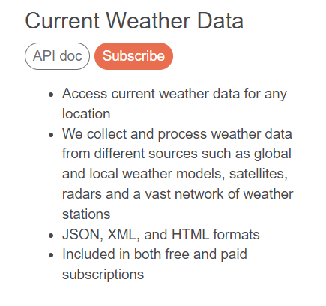
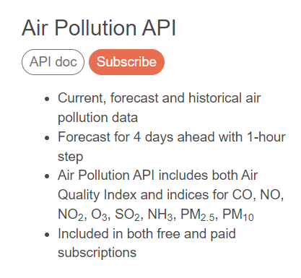
Context
Two APIs are called: one for current weather and one for air pollution.
Only one location is shown per call.

Slide 4
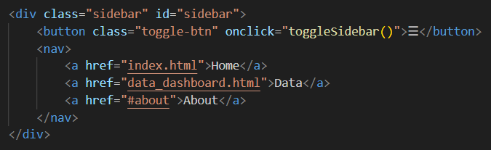
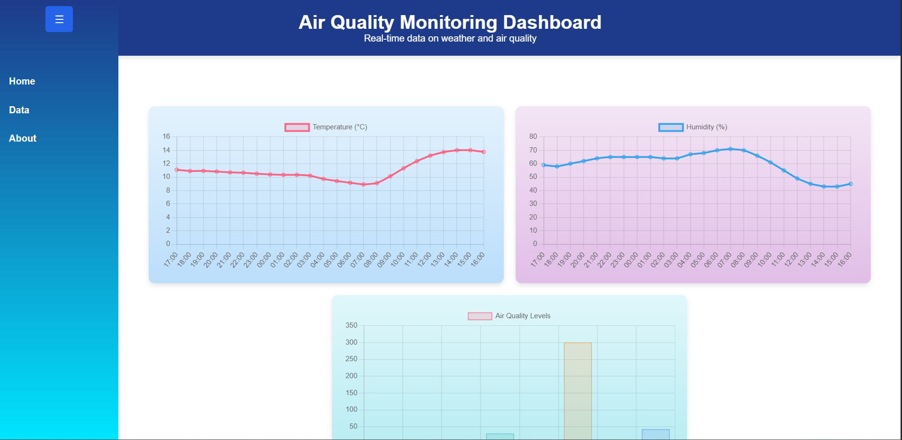
Navigation bar
The sidebar includes a Show/Hide button and three navigation links: Home, Data, and About.
The About page is not yet implemented.

Slide 5
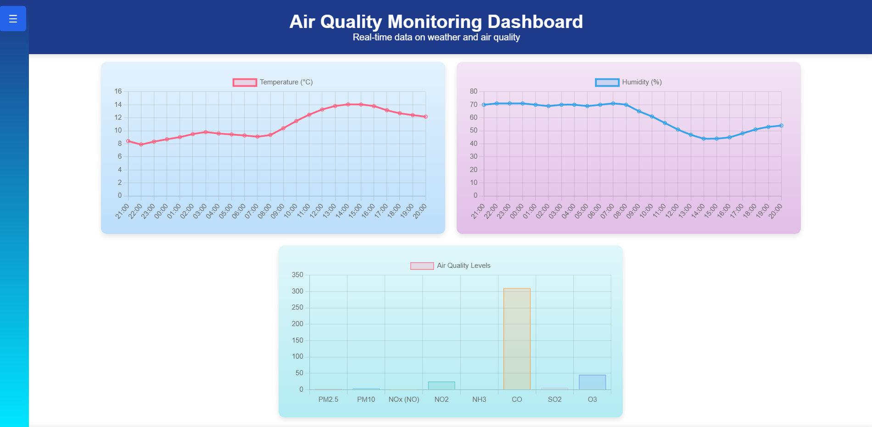
Navigation bar
Home page:
Three charts: Temperature, Humidity, and Air Quality.
There are currently issues with time labels, and a doughnut chart has not been added yet.

Slide 6
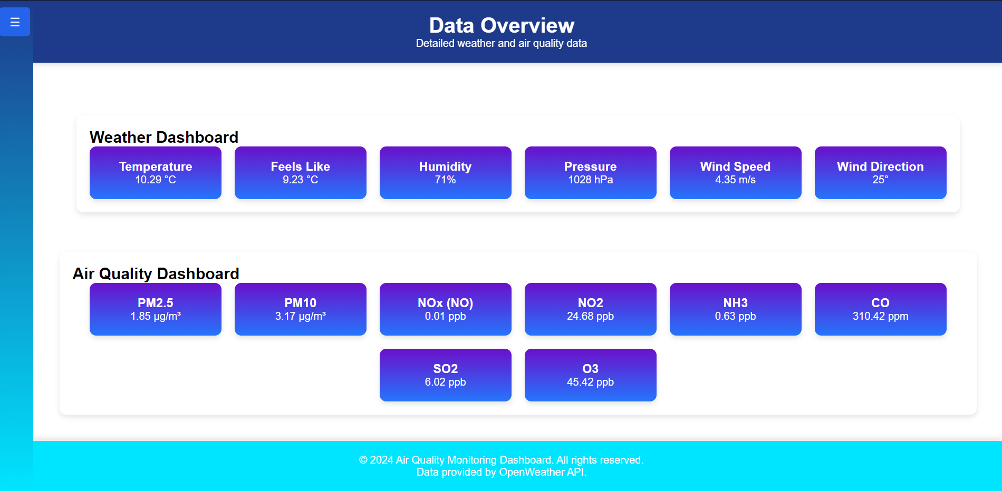
Navigation bar
Data page:
Displays all data retrieved from the API.
Only shows data for the location specified in the code.

Slide 7
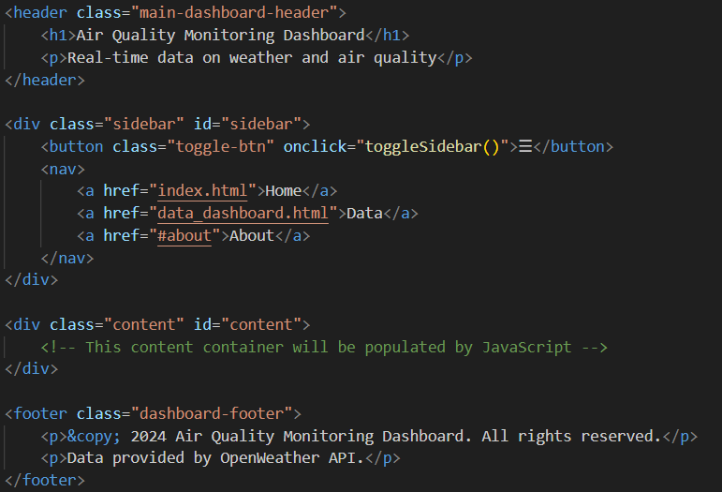
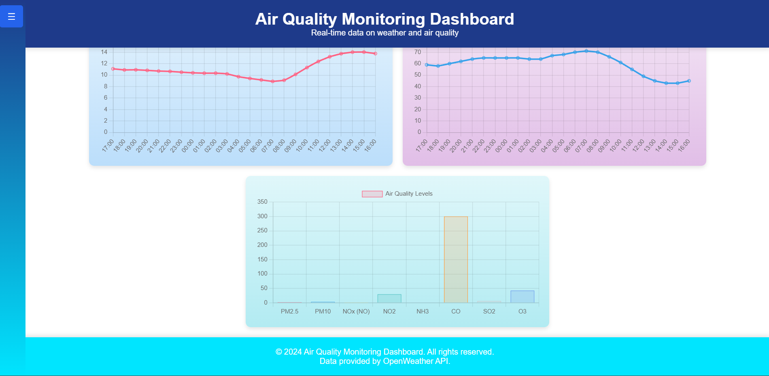
Header & footer
Includes a header for the title and a footer for copyright information.
The footer text needs to be made more readable.

Slide 8
Future upgrades
Add a location selection feature
Create the About page
Add a doughnut chart
Improve the readability of the footer text
Add a fullscreen mode for charts when clicked

Slide 9
Demo:
https://dokanii.github.io/air-quality-dashboard/

Slide 10
Any questions ?

